Slide 1

HTML/CSS/JavaScript Training
Session 1 – Introduction to HTML

Slide 2
HTML – Hypertext Markup Language
HTML is a language for describing web pages. It is a markup language that web browsers use to interpret and compose web pages with text, images and other visual or audible contents.
HTML is a markup language
A markup language is a set of markup tags
The tags describe document content
HTML documents contain HTML tags and plain text
HTML documents are also called web pages
HTML Tags
HTML markup tags are usually called HTML tags
HTML tags are keywords (tag names) surrounded by angle brackets like <html>
HTML tags normally come in pairs like <b> and </b>
The first tag in a pair is the start tag, the second tag is the end tag
The end tag is written like the start tag, with a forward slash before the tag name
Start and end tags are also called opening tags and closing tags
<tagname>content</tagname>
HTML Elements
"HTML tags" and "HTML elements" are often used to describe the same thing but an HTML element is everything between the start tag and the end tag, including the tags:
<p>This is a paragraph.</p>

Slide 3
HTML Page Structure
<!DOCTYPE html>
<HTML>
</HTML>
<HEAD>
<TITLE>Page Title</TITLE>
</HEAD>
<BODY>
<H1>Content Heading</h1>
<p>Content Paragraph</p>
</BODY>

Slide 4
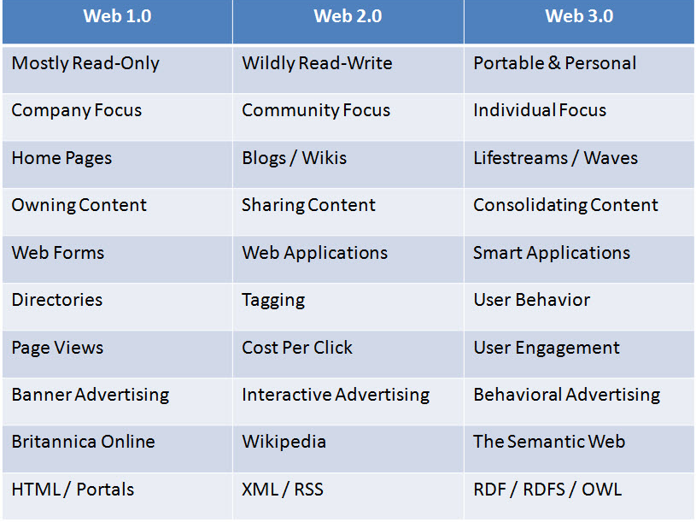
HTML Version History
HTML
HTML+
HTML 2
HTML 3.2
HTML 4
XHTML 1.x/XHTML 2.0
HTML 5

Slide 5
Web Technologies Stack

Slide 6
The Roles of Web Technologies
Web Technology | Role
HTML | Structuring Contents and Semantics
CSS | Content decoration, styling and design
JavaScript | Processing user events and client-side behavior
Web Browser | Retrieving, Presenting and Traversing information resources on the World Wide Web. Composition of HTML elements, execution of JavaScript and applying CSS styling.
W3C | Managing Web Standards and HTML Specifications
Browser Vendors/Providers | Development of Web Browsers considering web standards and specifications provided by W3C
Web Server | Hosting web application, processing browser requests, and executing server scripts
Server Scripts (JSP,PHP,ASP) | Generating dynamic HTML pages

Slide 7
HTML 5
HTML5 is a cooperation between the World Wide Web Consortium (W3C) and the Web Hypertext Application Technology Working Group (WHATWG). WHATWG was working with web forms and applications, and W3C was working with XHTML 2.0.
Some rules for HTML5 were established:
New features should be based on HTML, CSS, DOM, and JavaScript
Reduce the need for external plugins (like Flash)
Better error handling
More markup to replace scripting
HTML5 should be device independent
HTML 5 Features
New Elements and Attributes
Full CSS3 Support
Video and Audio
2D/3D Graphics (Canvas)
Local Storage
Local SQL Database
Web Workers
Web Sockets

Slide 8
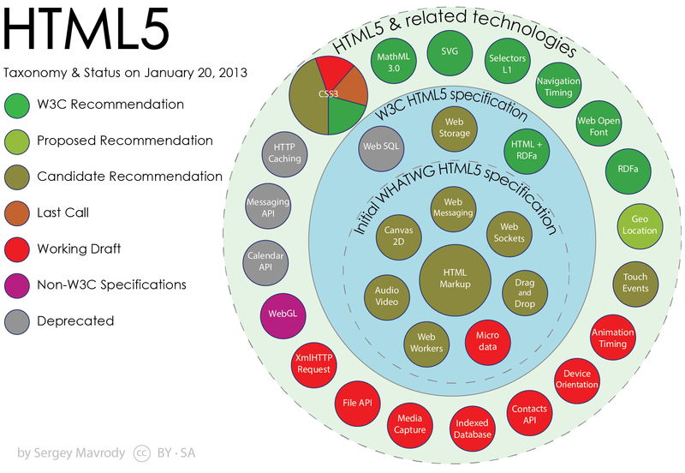

Slide 9
HTML 5 Document Structure
<!DOCTYPE html> <html> <head> <meta charset=“UTF-8”> <title>Page Title</title> </head> <body> <!– Page Contents -->
</body> </html>

Slide 10
Semantic HTML
Semantic HTML is a way of writing HTML that emphasizes the meaning of the encoded information over its presentation (visual contents). HTML has included semantic markup from its inception, but has also included presentational markup, such as <font>, <i> and <center> tags. There are also the semantically neutral <span> and <div> tags.
Semantic = Meaning.
Semantic elements = Elements with meaning.
HTML 5 Sematic Elements
<article> | Defines an article
<aside> | Defines content aside from the page content
<figcaption> | Defines a caption for a <figure> element
<figure> | Specifies self-contained content, like illustrations, diagrams, photos, code listings, etc.
<footer> | Defines a footer for a document or section
<header> | Specifies a header for a document or section
<mark> | Defines marked/highlighted text
<nav> | Defines navigation links
<section> | Defines a section in a document
<time> | Defines a date/time

Slide 11
Using Semantic HTML Elements

